Slide 1
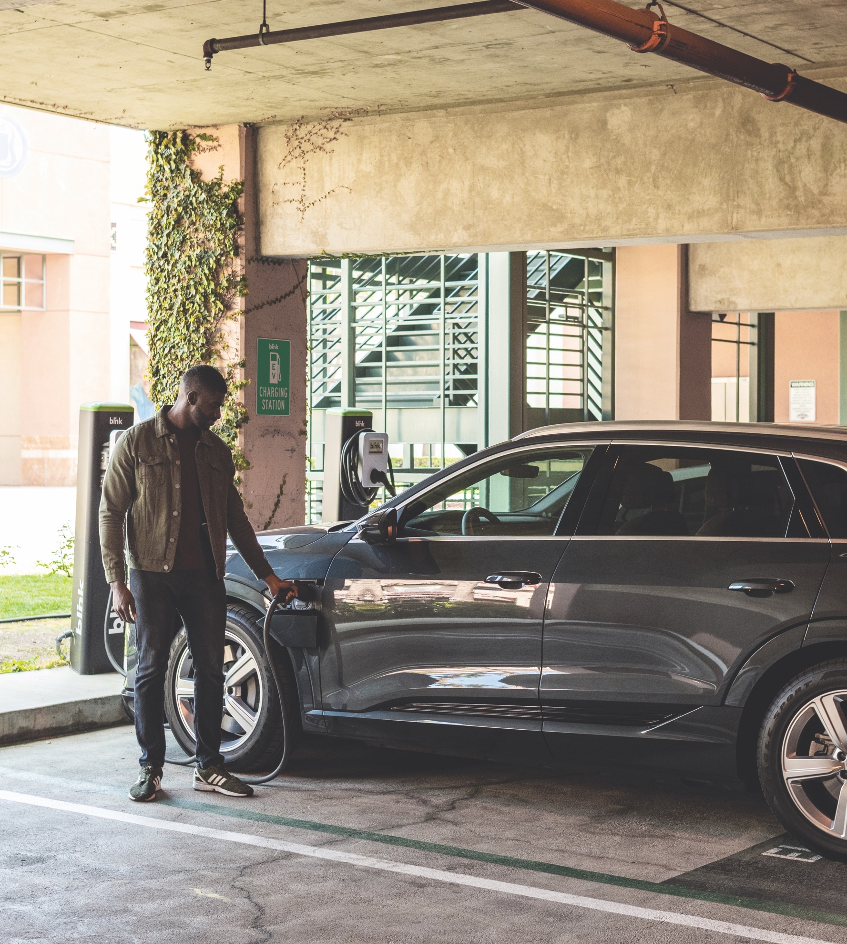


EV CHARGING SOLUTIONS
PREPARING FOR THE ELECTRIC FUTURE
www.BlinkCharging.com

Slide 2


Mark LaVigne PhD
Deputy Director

Slide 3
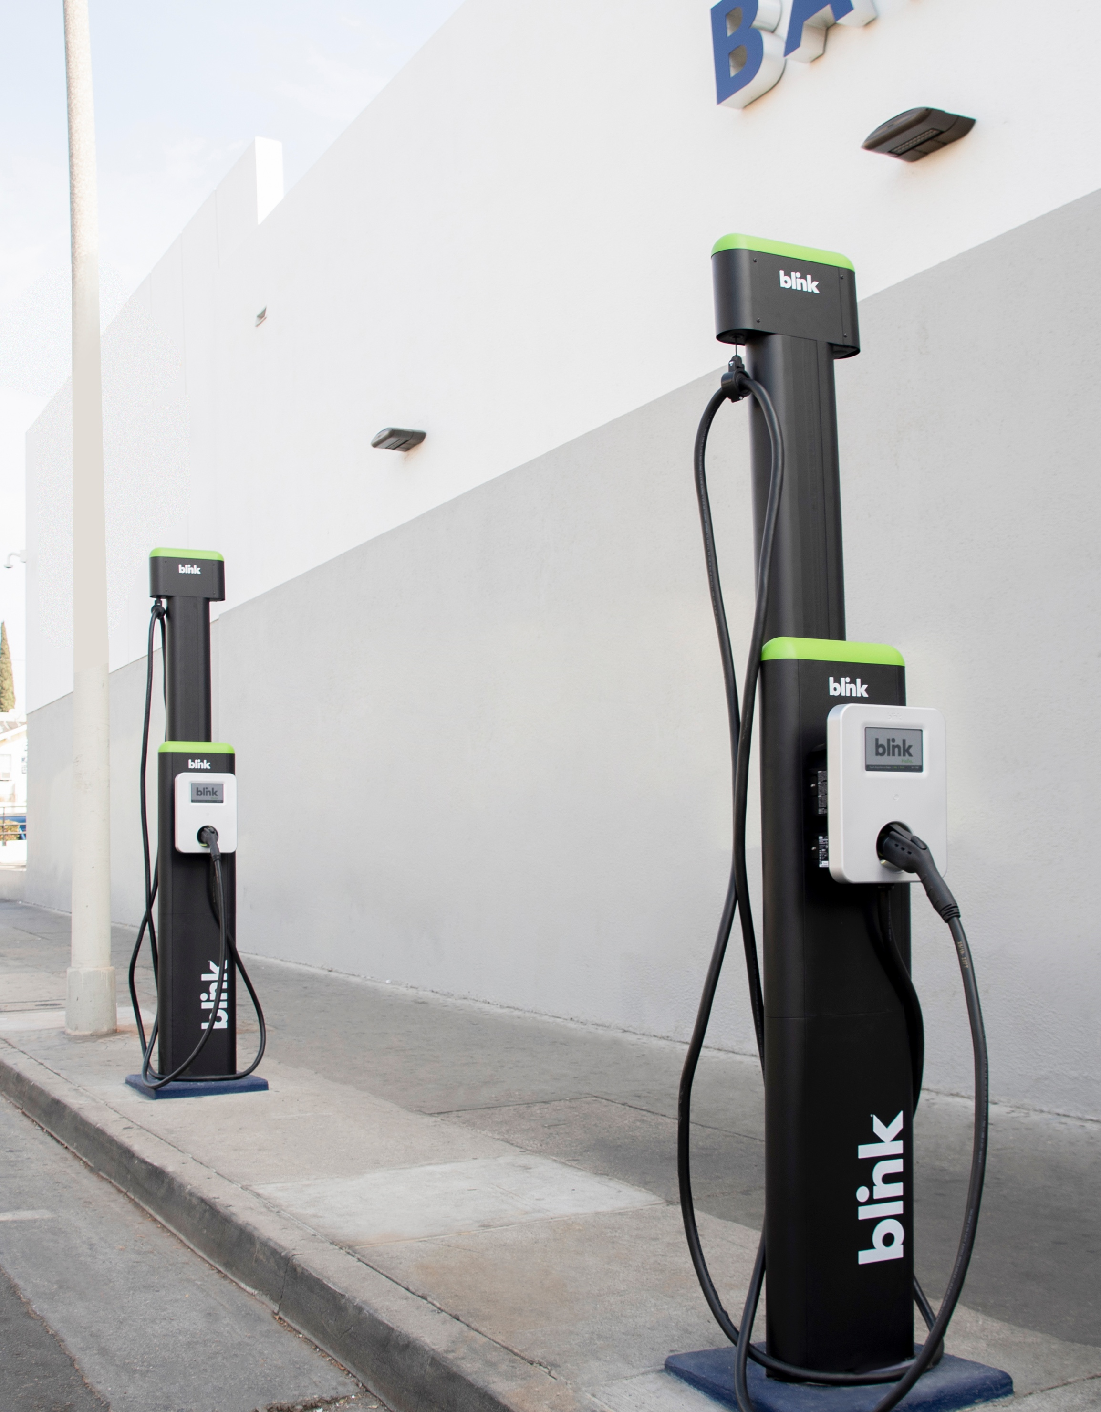
Agenda
Learning Objectives
The current state of electric vehicles and EV charging.
The basics of EV charging speeds, plugs and network.
Funding opportunities and incentives in New York.
Explore Blink's EV charging solutions and opportunities.
How to get started with EV charging with Blink.

Slide 4


Meet the Experts
Charles Hoyt
Executive Sales Manager, Northeast
Matt Chen
Director of Government Affairs

Slide 5


Value Proposition
Global Reach and 12 Years of Experience
Blink Offices: US, Belgium, Netherlands, United Kingdom, Greece, India, Israel
Founded in 2009
NASDAQ: BLNK
Vertically Integrated
Technology Center
30+ Full-Time Software Developers
Leading the Charge
for Interoperability in the US
Blink Owns & Operates over 5,000 charging stations
>66,000+ chargers sold or deployed to date
500,000+ members registered
London, United Kingdom
Amsterdam, Netherlands
Antwerp, Belgium
Los Angeles, CA
Bowie, MD
Tempe, AZ
Miami, FL
Tel Aviv, Israel
Delhi, India
Bangalore, India

Slide 6
Market Trends
The Demand for Electric Vehicles
US Electric Vehicles Sales Forecast: 2019-2028
100 additional Electric
Vehicle models will be brought
to market by 2024
-Automotive News
Forecast: Loren McDonald/EVAdoption.com
BlinkCharging.com • (888) 998.2546
EV Charging Solutions with Blink
© 2023 Blink Charging Co. All Rights Reserved.
Notes:
EV MODELS TO COME

Slide 7
Market Trends
The Demand for EV Charging Infrastructure
Forecasted U.S. EV Charger Sales in 1,000’s
Key Industry Drivers
Forecasted 30% of EV adoption CAGR⁽²⁾
Expansion of grant opportunities
Legislation mandating EV infrastructure
Source: Guidehouse (Navigant) Market Analysis
and Forecast of EV Charging Solutions 2Q-2020
BlinkCharging.com • (888) 998.2546
EV Charging Solutions with Blink
© 2023 Blink Charging Co. All Rights Reserved.
Notes:
Key Industry Drivers
Forecasted 25% compound annual growth
rate (CAGR) increase in EV adoption
Expansion of grant opportunities
Legislation mandating EV infrastructure

Slide 8
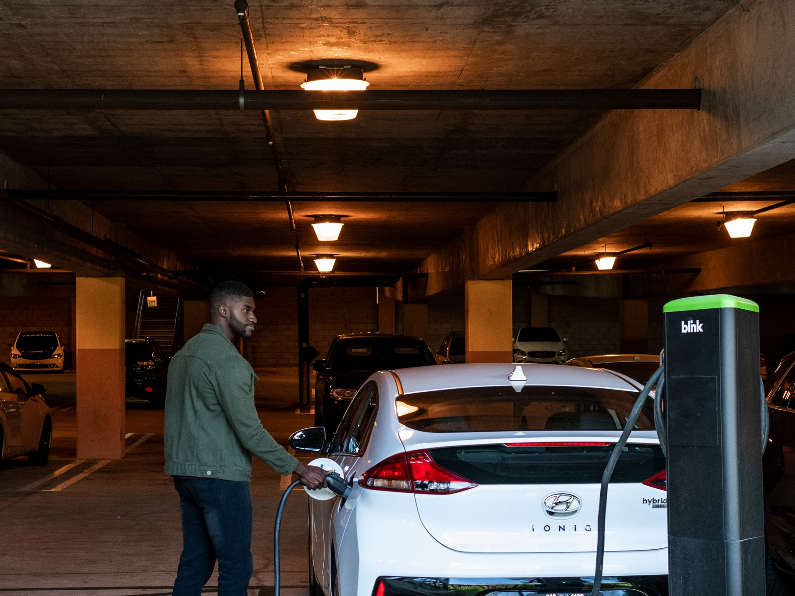
EV Charging Basics
BlinkCharging.com • (888) 998.2546
EV Charging Solutions with Blink
© 2023 Blink Charging Co. All Rights Reserved.

Slide 9
EV Charging Basics
US Plug Types
 | Level 1 | Level 2 | DCFC
Application | Home overnight charging | Public commercial charging | Highway/road trip charging
Ideal For | Short commuters | Public, workplace and destination charging | Roadside and highway applications
Voltage | 120V | 240V | 480V
Plug
Charging Time | 12+ hrs | 4-8 hrs to 100% | 30mins. To 80%
Avg. Install Cost | $0 | $5,000-$10,000 | $30,000+
Standard Wall Plug
J1772
Tesla
CCS Combo
CHAdeMo
Tesla Supercharger
2-5 MILES
PER HOUR OF CHARGE
WITH LEVEL 1
40-65 MILES
PER HOUR OF CHARGE
WITH LEVEL 2
80% CHARGE
IN 30-40 MINUTES
WITH DC FAST
BlinkCharging.com • (888) 998.2546
EV Charging Solutions with Blink
© 2023 Blink Charging Co. All Rights Reserved.

Slide 10
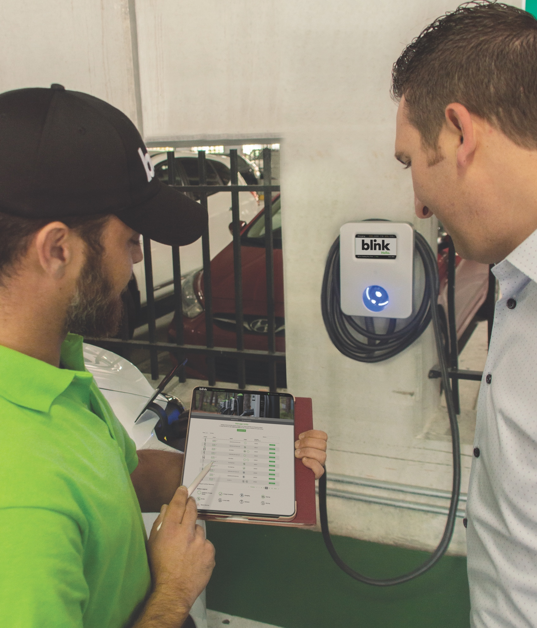
EV Charging Basics
Network VS.
Non-Networked Chargers
Advantages of Networked Chargers
Payment collecting and processing
Third party map integration (Apple Maps, Google Maps Plugshare, etc.)
Delegate management from different charging locations
Charger activation and scheduling
Driver monitoring and alerts
Remote trouble shooting
BlinkCharging.com • (888) 998.2546
EV Charging Solutions with Blink
© 2023 Blink Charging Co. All Rights Reserved.

Slide 11
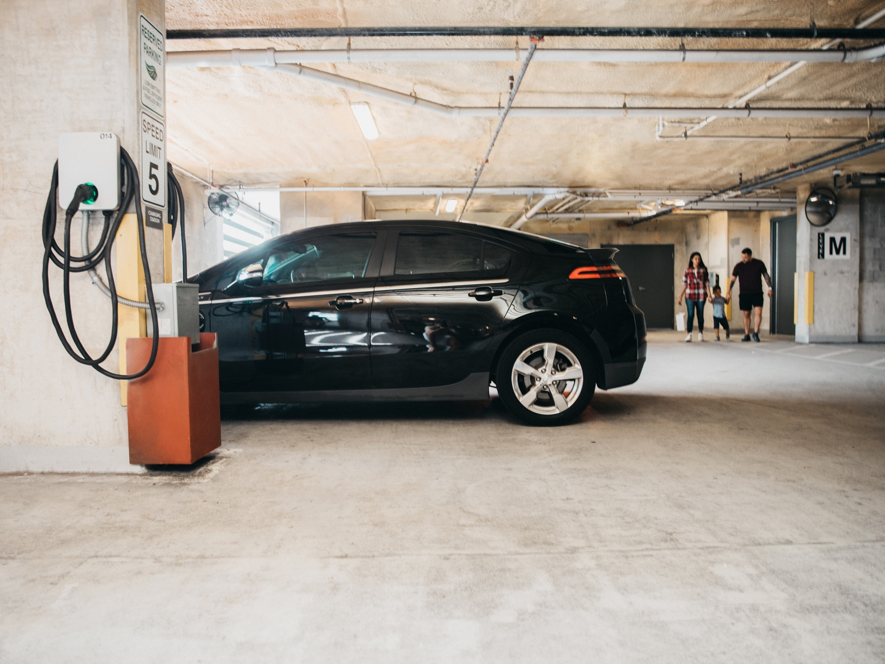
Incentives for EV Charging
BlinkCharging.com • (888) 998.2546
EV Charging Solutions with Blink
© 2023 Blink Charging Co. All Rights Reserved.

Slide 12
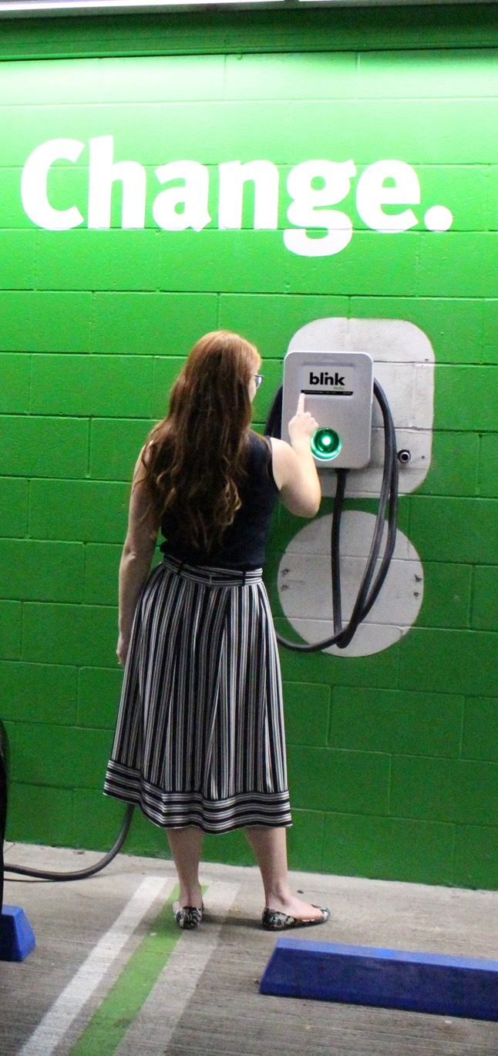
Incentives for EVSE
Grants, Rebates and Tax Credits
A variety of incentives are available to businesses interested in deploying Blink EV charging stations at their location. Incentives may come in the form of grants, rebates or tax credits.
Incentives May Come from:
Federal government
State government
Local sources
Utility companies
What is Available?
Your business may be eligible for a U.S. federal tax credit. Businesses located in eligible census tracts may receive a base credit of 6% (up to $100,000) per charger. There is also an add-on credit for meeting wage and apprenticeship requirements.
View commercial & residential incentives at Blinkcharging.com/Businesses/Commercial-Incentives
BlinkCharging.com • (888) 998.2546
EV Charging Solutions with Blink
© 2023 Blink Charging Co. All Rights Reserved.

Slide 13
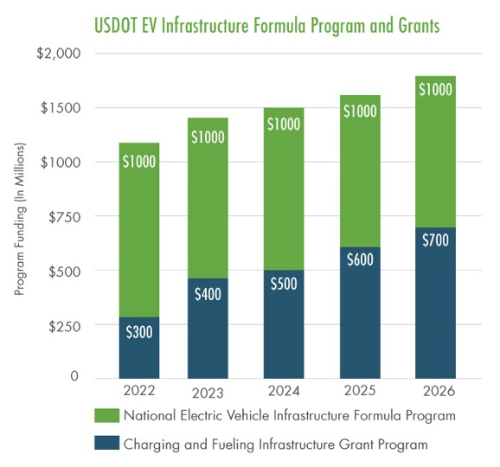
BIL Goals
Bipartisan Infrastructure Law Goals
Deploy a network of EV fast chargers to reduce range anxiety and encourage EV adoption by more drivers
Address the climate crisis
Facilitate long-distance EV travel
Provide convenient charging where people live, work, and shop
Support domestic, good paying, manufacturing jobs
Focus on rural, disadvantaged, and hard-to-reach communities
$7.5 Billion Available
Over 5 Years
$5 Billion For
NEVI Formula-Driven Funding
$2.5 Billion Available
for Discretionary Grants
$175 M
New York State
EV Charging Solutions with Blink
© 2023 Blink Charging Co. All Rights Reserved.
Notes:
Chart shows anticipated release of funds. The 1st $5 billion - each state has been allocated funds to invest. The second $2.5 Billion round of funding will be for competitive discretionary grants.

Slide 14
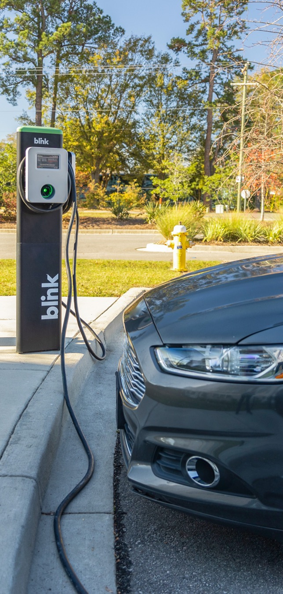
Incentives for EVSE
DOT Grant program for EV chargers, alternative fuels
The U.S. Department of Transportation’s new Charging and Fueling Infrastructure (CFI) Discretionary Grant Program awards competitive grants to infrastructure projects to fill gaps in the national charging and alternative-fueling network.
$2.5 Billion in Funding from the Charging and Fueling Infrastructure program will:
Flow directly to state and local agencies to build infrastructure for electric, hydrogen, propane and natural gas vehicles.
Be split equally between state-designated alternative fuel corridors and community gathering points like stores and apartment complexes, the latter of which will be prioritized for rural areas and disadvantaged communities.
Mostly fund slower, “Level 2” chargers at common stopping points and near residences.
Go to a range of state, local and tribal agencies and the grants are discretionary.
Who is eligible?
City or township governments
Public and State controlled institutions of higher education
Special district governments
Native American tribal governments (Federally recognized)
Public housing authorities/Indian housing authorities
County governments
State governments
BlinkCharging.com • (888) 998.2546
EV Charging Solutions with Blink
© 2023 Blink Charging Co. All Rights Reserved.

Slide 15
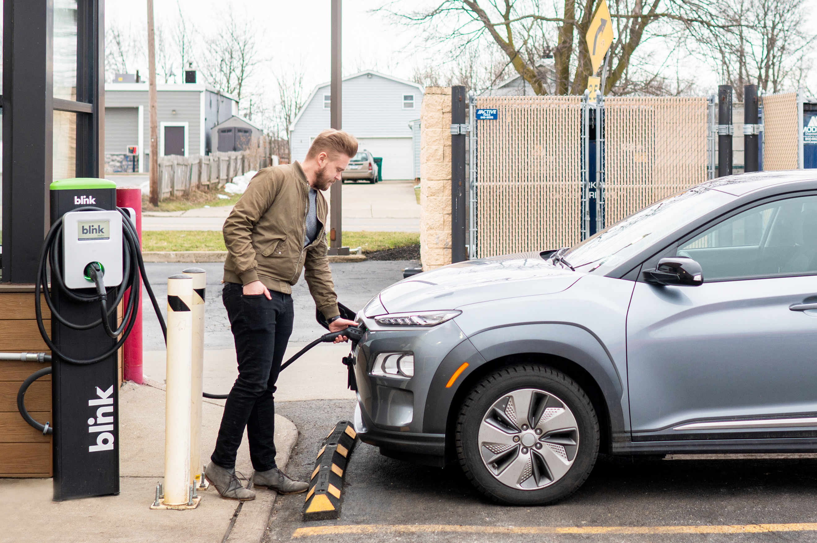
New York Focus
New York EV Policies
Clean Fleets NY supports deployment of charging
infrastructure and light-duty EVs in government fleets.
New vehicles sold are to meet CA emission standards.
The approved NY Scoping Plan goals:
  3 million EVs on the road by 2030
  Achieving 70% renewable energy by 2030
  Cutting emissions 40% by 2030
  Building codes requiring EV charging readiness
Up to $2,000 for EVs
Drive Clean Rebate
Up to $385k for EV Trucks & Buses
New York State Truck Voucher Incentive
Success Story
Blink announced the deployment of 42 Blink IQ 200 charging ports at ten Four Brothers Pizza In locations across New York.
The dual-port chargers were made possible through the Charge Ready program from the New York State Energy Research and Development Authority (NYSERDA) and the Make Ready incentive offered by New York utilities. These rebates and incentives facilitated the charger installations at little to no cost to Blink or Four Brothers – further expanding EV infrastructure in the area.
Up to $4,000 per Charging Port
Charge Ready NY Program
Up to $8,000 per Charging Port
Clean Fleets NY
EV Charging Solutions with Blink
© 2023 Blink Charging Co. All Rights Reserved.

Slide 16
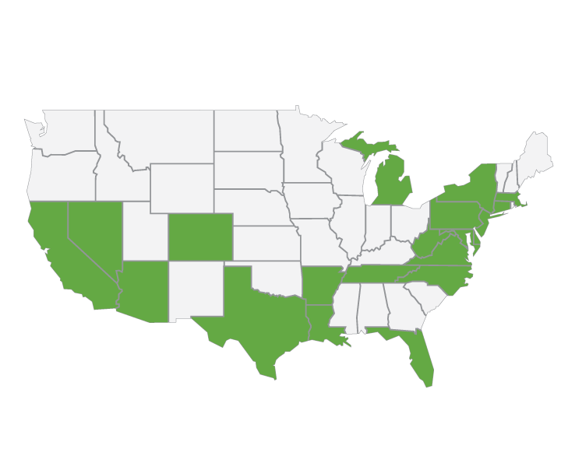
Funding Your Project
State and Utility Programs
Incentive programs vary from state and even city by city. Some programs will pay for the installation and equipment up front, while some re-reimburse you the installation, cost etc.
New York
In some states like NY, you may combine an installation rebate with an equipment incentive. National Grid offers a Make Ready incentive that will cover up to 100% of electrical infrastructure costs.
Connecticut
The EverSource program covers between
$20k - $40k for the make-ready costs, plus additional 50% for hardware costs.
New Jersey
The Atlantic City Electric (ACE) fleet charger program allows fleets vehicles to qualify for rebates covering up to 50% of eligible installation costs up to $2,500 per port, for a maximum of 10 ports.
Virginia, West Virginia, Maryland
Blink Charging in association with Virginia Clean Cities has been awarded a grant to deploy 200 Blink charging stations across the mid-Atlantic region.
North Carolina
The North Carolina Department of Environmental Quality (NCDEQ) is soliciting proposals for grants to install new DCFC stations at sites along priority corridors. NCDEQ anticipates awarding approximately $4.9 million in Phase 2.
California
Southern California Edison (SCE) is budgeting over $400 million for up to
$4,000 per Level 2 connector at destinations in its service territory.
Arizona
The Tucson Electric Power (TEP) program covers up to 85% of project costs, & up to $6,000 per port.
Nevada
Nevada Energy will cover up to 75% of Level 2 and DCFC project costs. Level 2 installations with up to 10 connectors can get up to $5,000 per charging port. DCFC can get $400 per kW per charging station, up to five DCFC stations per site.
Louisiana
Entergy will cover all infrastructure costs for fleets (typically $250 per Level 2 port and $1,500 per DCFC port).
EV Charging Solutions with Blink
© 2023 Blink Charging Co. All Rights Reserved.

Slide 17
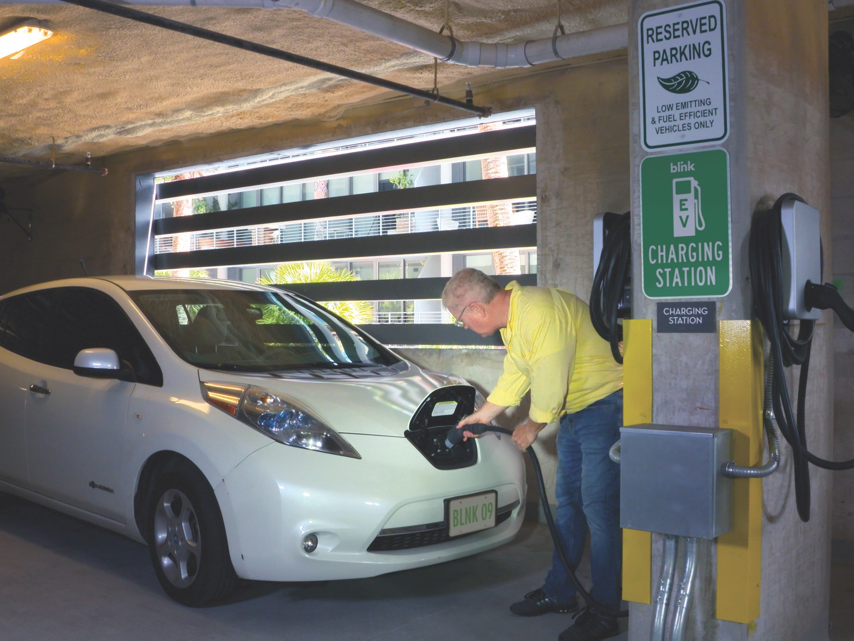
About Blink
BlinkCharging.com • (888) 998.2546
EV Charging Solutions with Blink
© 2023 Blink Charging Co. All Rights Reserved.

Slide 18
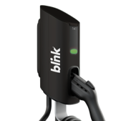
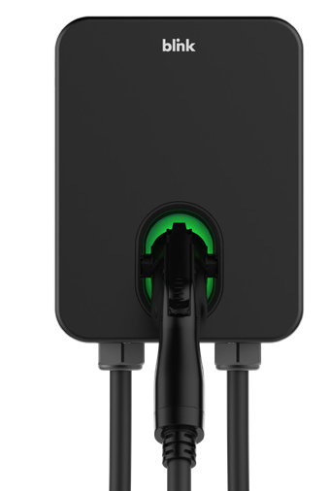
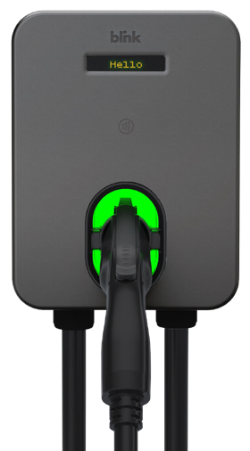
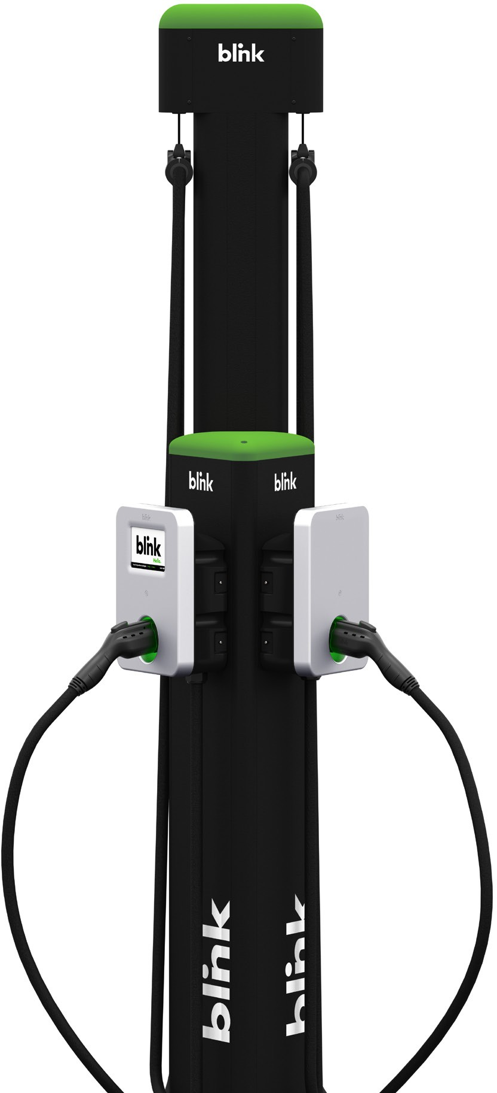
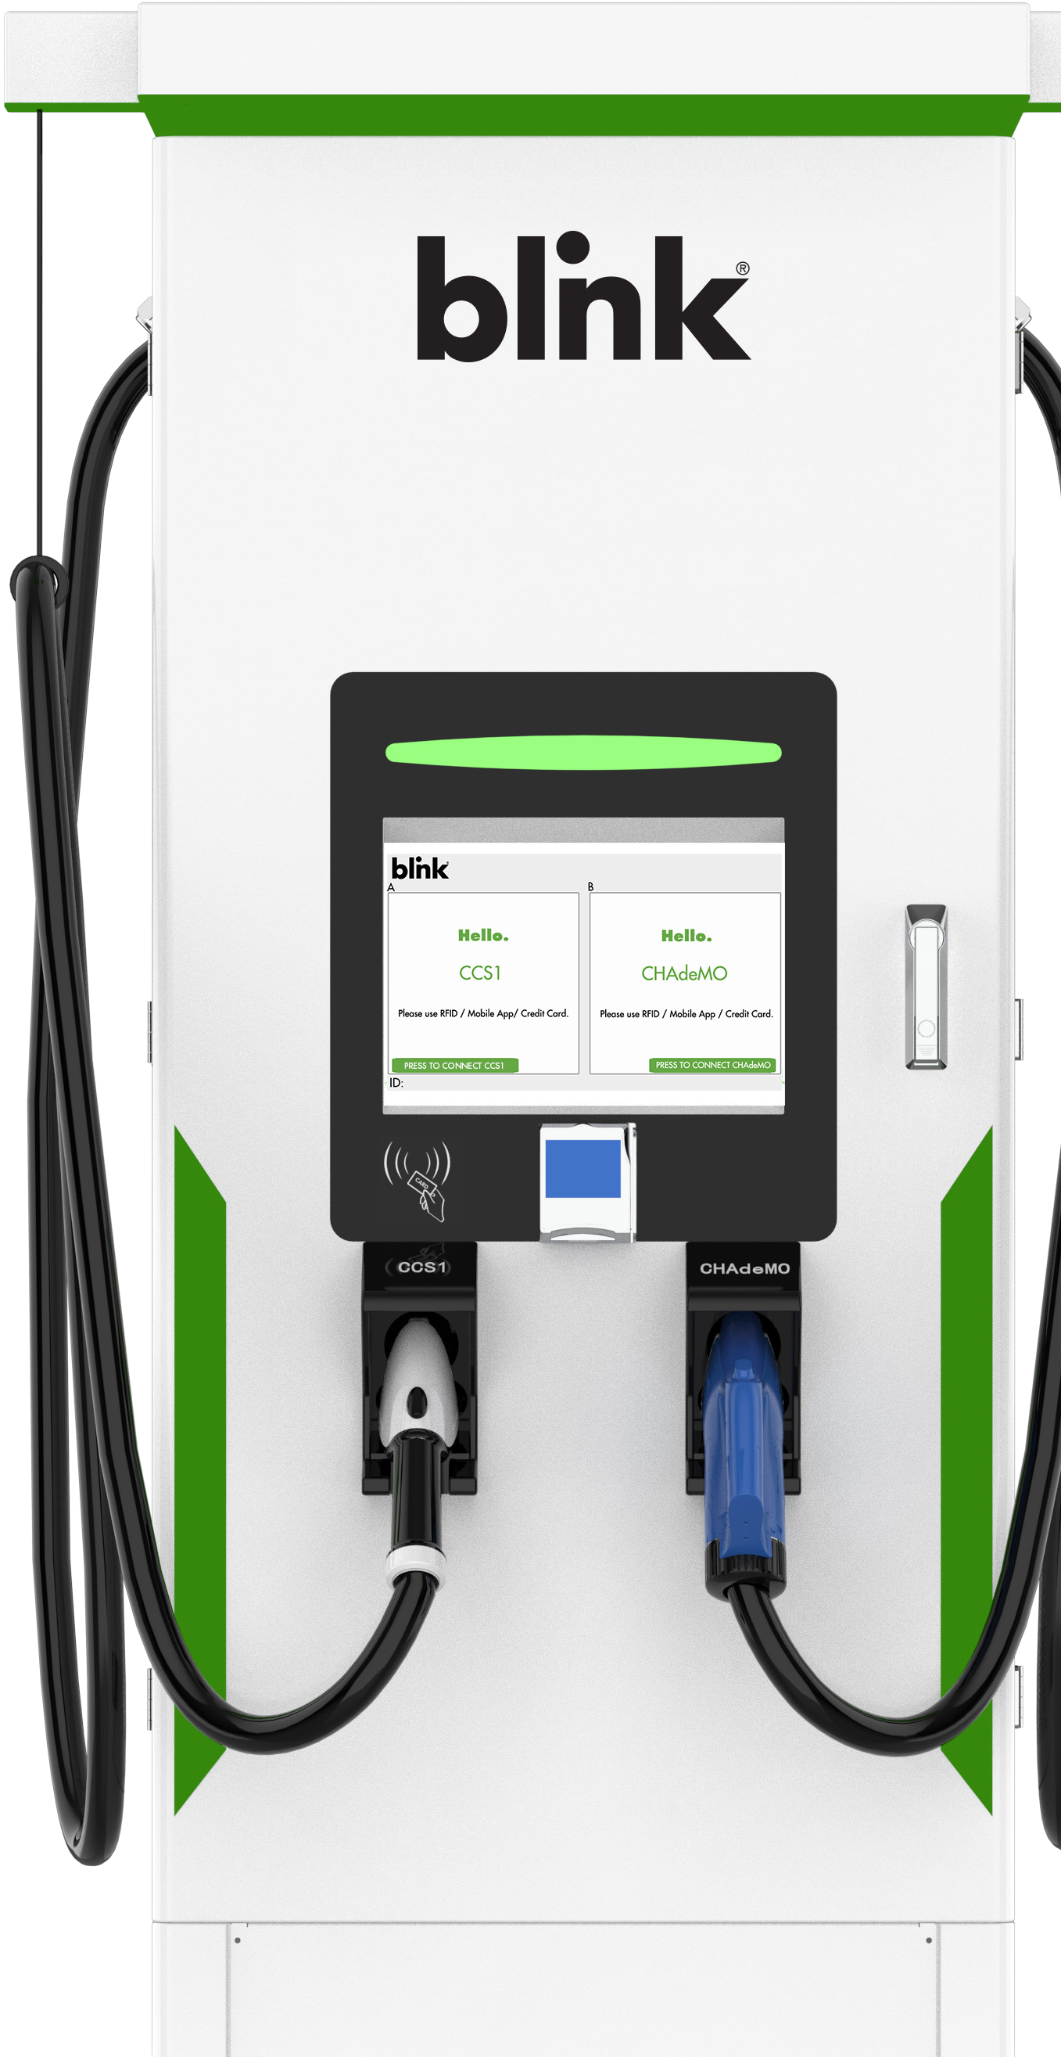
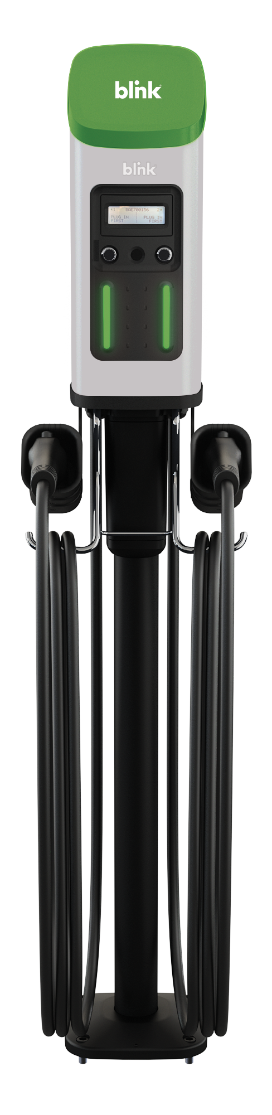
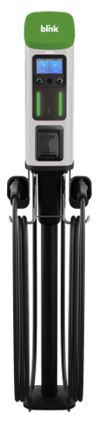
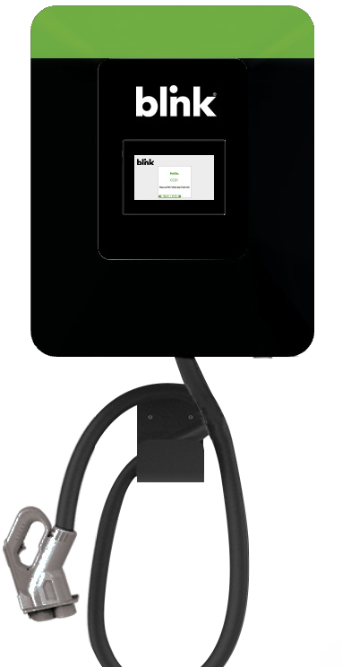
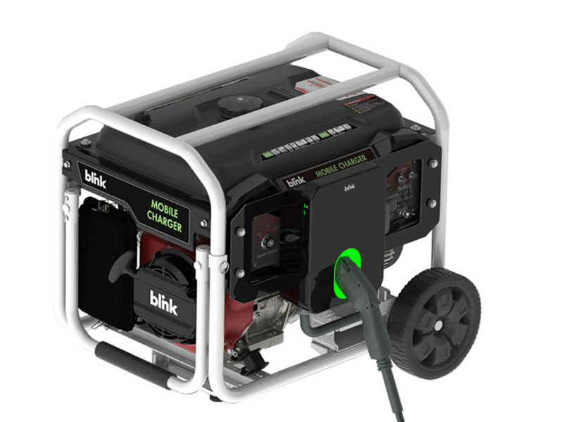
Blink Family of Products
Blink Product Overview
IQ 200
Wall, Pedestal, or
Pole Mounted Commercial Level 2 Charger
Series 8
DC Fast Charging
From 60kW-360kW
Powerful, flexible mounting options and credit card payment capable
Level 2 Charger
High Performance
Fast Charging Meets
Small Footprint
Series 7
Powerful, flexible mounting options Level 2 Charger
Series 4
Level 2
Wall Mounted
Home Charger
HQ 200
Level 2
Wall Mounted Home Charger
MQ 200
Level 2 Wall Mounted Fleet and Multifamily Charger
DC Fast Charging
30kW Options, High Performance Fast Charging Meets Small Footprint
Mobile Charger
Level 2 Generator-Powered Charger

Slide 19

Blink Product Overview
The Blink Network
The Power of Our Software Systems
Advantages
Reporting capabilities include revenue, sustainability
reports and more
Remote EV station monitoring
Streamlined payment processing
Integration with Google, Apple, Blink and other popular
map applications
Charging station health monitoring and Level 1 and 2 support
Flexible pricing controls at the station or user level
BlinkCharging.com • (888) 998.2546
EV Charging Solutions with Blink
© 2023 Blink Charging Co. All Rights Reserved.

Slide 20
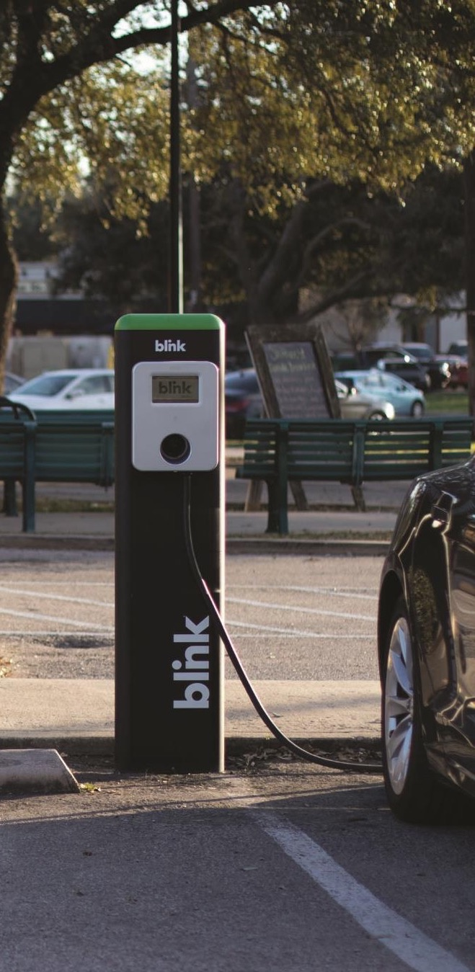



Blink Product Overview
Blink Opportunities
Blink Business Models
Host Owned
Purchase Blink chargers with local, regional, or state funding opportunities. Find out if you qualify at Blinkcharging.com/Businesses/Commercial-Incentives
Blink as a Service
Looking to simply pay a low flat fee each month to offer chargers? Through the Blink as a Service program costs start as low as $99/month.
Hybrid Owned
This revenue share model splits the costs and the revenue generated with your location and Blink to provide publicly accessible EV chargers.
Blink Owned Turn Key
If you have a high-traffic location that isn’t 1 mile from a corridor, you may qualify for the Blink Owned Turn Key offering. Blink will provide the installation, equipment, operations, and administration of EV charging equipment at no cost to you.
EV Charging Solutions with Blink
© 2023 Blink Charging Co. All Rights Reserved.

Slide 21
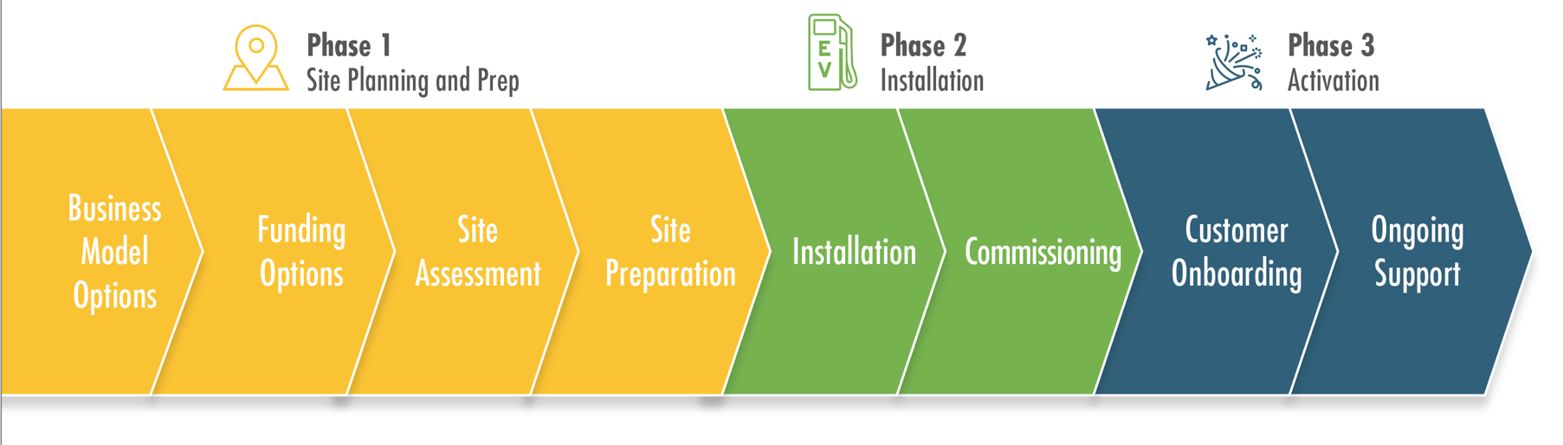
Planning Your Project
How to Install an EV Charging Station
Blink will help you understand the most cost-effective way to deploy EV chargers at your property.
From early conversations to the initial site walk-through site prep and installation, our team will help you understand where and how to deploy chargers and promote them to EV drivers.
EV Charging Solutions with Blink
© 2023 Blink Charging Co. All Rights Reserved.

Slide 22
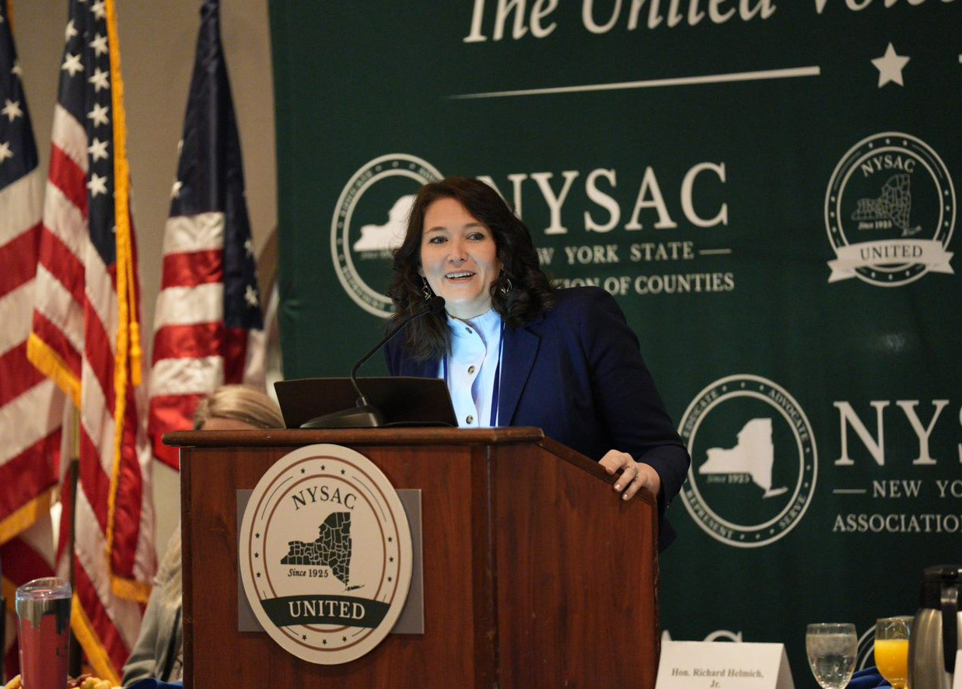

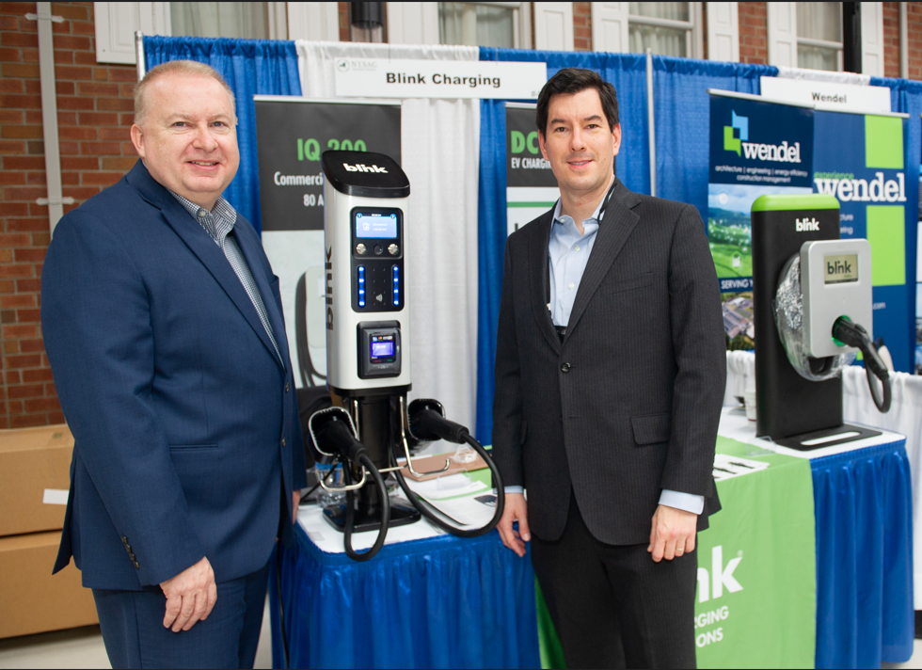
Collaboration
NYSAC Legislature Conference
Blink Attends NYSAC Legislature Conference in Albany
On March 1st, Amy Dobrikova, Vice President of Fleet, and Matt Chen, Director of Government Affairs, attended the NYSAC Legislature Conference where Blink participated in a panel discussion and exhibited Blink EV Charging Solutions.
EV Charging Solutions with Blink
© 2023 Blink Charging Co. All Rights Reserved.

Slide 23
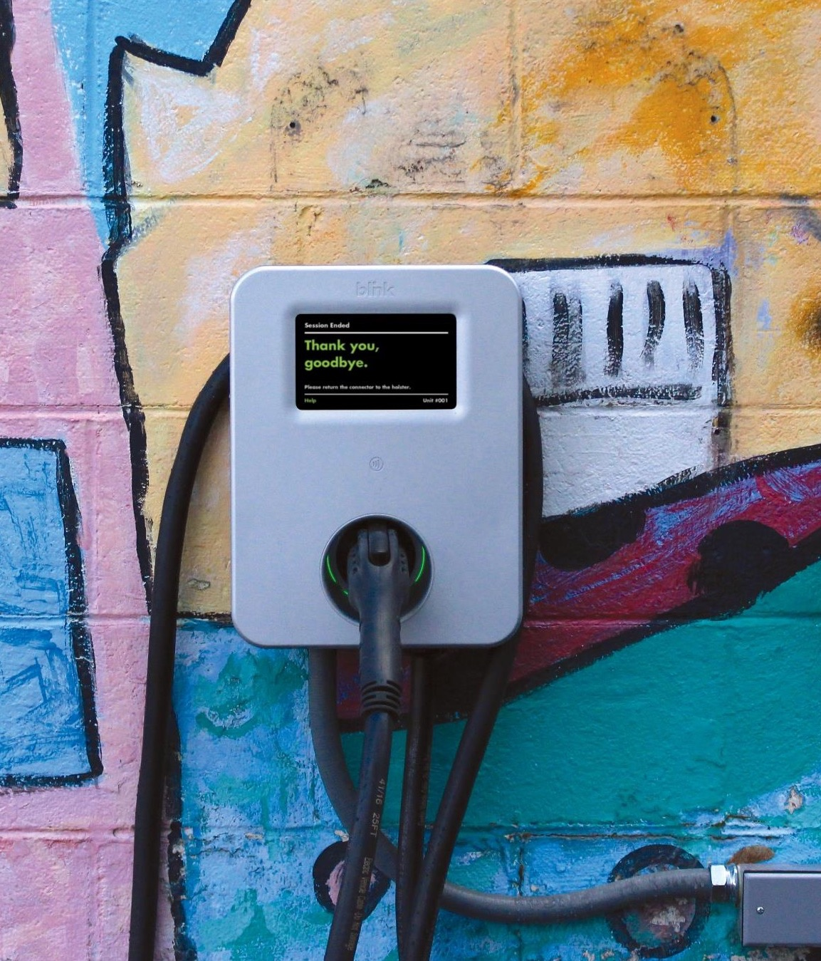

Q & A
Thank you for joining us!
Charles Hoyt
CHoyt@BlinkCharging.com
Blink Charging
605 Lincoln Road, 5th Floor
Miami Beach, FL 33139
NASDAQ:BLNK
www.BlinkCharging.com
SS01-19VII-03

